Slide 1

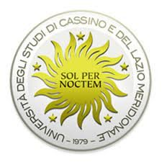


Enhancing Multiclass Skin Lesion Classification: A Deep Learning vs. Hybrid Deep Learning-Machine Learning Comparison
ISIC 2017 SKIN LESION CLASSIFICATION CHALLENGE:
Presentation by:
Daniel Tweneboah Anyimadu

Slide 2
ABSTRACT
The experiment is conducted on the ISIC 2017 skin lesion classification dataset. The project involves data acquisition and preprocessing, development of CNN architecture, classification and feature extraction, training and fine-tuning of machine learning models, and evaluation of performance.
The models are evaluated based on their overall accuracy and Balanced Multiclass Accuracy on a test dataset.
The hybrid model outperforms the pure deep learning approach, achieving an 86.67% accuracy and 83.56% BMA compared to 76.83% accuracy and …% BMA for pure deep learning.
This study presents a multiclass skin lesion classification challenge and leverages two distinct approaches: pure deep learning and hybrid deep learning-machine learning, to assess by comparing their performance on this challenge.
The aim is to enhance multiclass skin lesion classification leveraging these 2 approaches.
2

Slide 3
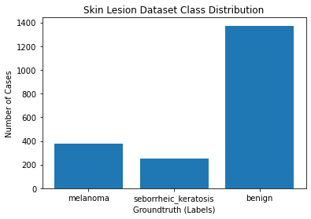
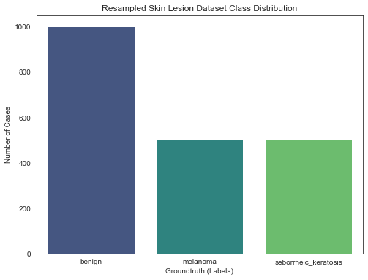
Exploratory Data Analysis (EDA) & Resampling
Class Distribution Plot:
Resampling Plot:
A visualization of class imbalance shown in the class distribution plot.
Resampling technique was utilized to address class imbalance while maintaining real-world skin lesion case distribution depicted in the resampling plot.
3

Slide 4
A Pure Deep Learning Approach
Convolutional Neural Network Architecture:
This is designed to automatically capture skin lesion features for multiclassification task.
4

Slide 5
Hybrid Deep Learning-Machine Learning Approach
Convolutional Neural Network:
The same CNN architecture was used to extract features as input for the ML models.
Machine Learning Models:
Different ML models, including random forest classifiers (RF), k-nearest neighbors (KNN), logistic regression (LR), and support vector machines (SVM), were trained using a supervised learning approach.
The rf model outperformed others making it the chosen final ML multiclassification model.
EVAL. METRIC / MODEL | accuracy | precision | recall | F1-score | roc_auc | bma
rf | 0.8667 | 0.8780 | 0.8667 | 0.8628 | 0.9291 | 0.8356
SVM | 0.645 | 0.6523 | 0.645 | 0.6165 |  | 0.5778
KNN | 0.6517 | 0.6404 | 0.6517 | 0.6400 | 0.8113 | 0.6133
lm | 0.6483 | 0.6484 | 0.6483 | 0.6245 | 0.7865 | 0.5878
5

Slide 6
COMPARATIVE ANALYSIS (ACCURACY, BMA)
MODEL | ACCURACY (TEST) | BMA (TEST)
Pure Deep-Learning | 0.7683
Hybrid Deep Learning-Machine Learning (rf) | 0.8667 | 0.8356
The results of the hybrid model outperforms the pure deep learning approach, achieving an 86.67% accuracy and 83.56% BMA compared to 76.83% accuracy and …% BMA for pure deep learning.
The hybrid approach, combining CNNs and Random Forest Classifier, reliably classifies skin lesions (benign, seborrheic keratosis, and melanoma), showing promising potential for accurate medical diagnosis.
6

